Slide 1
Reliance Industries Stock Analysis and Forecasting

Slide 2
Reliance Industries
Business Objective
Predict the Reliance Industries Stock Price for the next 365 days.
There are Open, High, Low and Close prices that you need to obtain from the web for each day starting from 2000 to 2024 for Reliance Industries stock.
Split the last year into a test set- to build a model to predict stock price.
Find short term, & long term trends.
Understand how it is impacted from external factors or any big external events.
Forecast for next 365 days.

Slide 3
Abstract:
This project aims to predict the stock prices of Reliance Industries Limited (RIL) for the upcoming 365 days by leveraging historical stock market data from January 1, 2000, to April 30, 2024. The primary goal is to identify both short-term and long-term trends, assess the impact of external factors and significant events, and provide accurate forecasts for the next month. The dataset includes daily records of key attributes such as Open, High, Low, Close, Adjusted Close prices, and trading Volume.
Various machine learning models, including Support Vector Regression (SVR), Random Forest, K-Nearest Neighbors (KNN), Long Short-Term Memory (LSTM), and Gated Recurrent Unit (GRU) networks, were developed and evaluated. Among these, the LSTM model demonstrated superior accuracy and was selected for deployment. The project employs Python and essential libraries such as NumPy, Matplotlib, SciPy, scikit-learn, TensorFlow, Keras, and Streamlit for data analysis, model building, and deployment.

Slide 4
Users can interact with the predictive model through a Streamlit-based web application, allowing them to make informed stock price predictions based on historical data. The project's deployment facilitates real-time analysis and decision-making for stakeholders, showcasing the integration of data science and software development skills in addressing the complexities of stock price forecasting. This work highlights the potential of advanced machine learning techniques in financial market analysis and prediction.

Slide 5
Introduction
Predicting stock prices is a complex yet crucial task in the financial industry, driven by the need for investors and stakeholders to make informed decisions. The stock market's inherent volatility and the influence of myriad external factors make accurate predictions challenging. This project focuses on forecasting the stock prices of Reliance Industries Limited (RIL) for the next 30 days, leveraging historical data to identify trends and patterns that can inform future price movements.
The dataset spans from January 1, 2000, to April 30, 2024, and includes essential attributes such as Open, High, Low, Close, Adjusted Close prices, and trading Volume. By utilizing this rich historical data, the project aims to capture both short-term and long-term trends, analyze the impact of significant events, and generate reliable forecasts.

Slide 6
A variety of machine learning models, including Support Vector Regression (SVR), Random Forest, K-Nearest Neighbors (KNN), Long Short-Term Memory (LSTM), and Gated Recurrent Unit (GRU) networks, were developed and assessed. The LSTM model, known for its effectiveness in time series forecasting, demonstrated the highest accuracy and was thus chosen for deployment.
The implementation of this project involves the use of Python and key libraries such as NumPy, Matplotlib, SciPy, scikit-learn, TensorFlow, Keras, and Streamlit. The final model is deployed via a Streamlit-based web application, providing an interactive platform for users to make stock price predictions based on historical data.
This project exemplifies the integration of data analysis, machine learning, and software development to tackle the intricate task of stock price prediction. It underscores the potential of advanced machine learning techniques in enhancing the accuracy of financial forecasts, thereby aiding investors and stakeholders in making data-driven decisions.

Slide 7
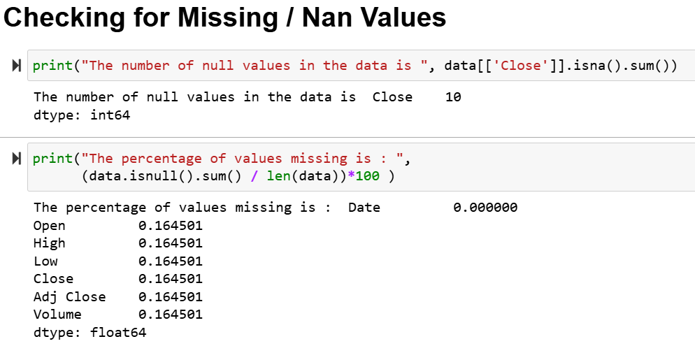
Preprocessing:

Slide 8
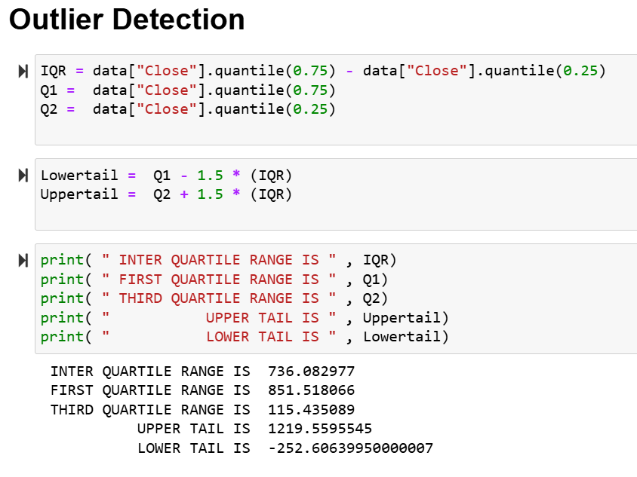
Outliers detection:

Slide 9
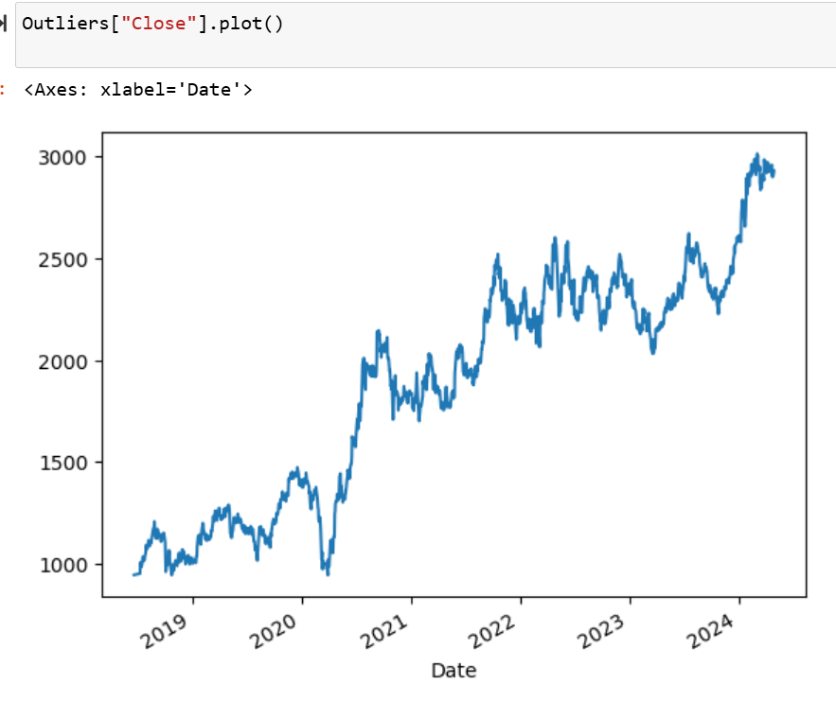
VISUALISATION:

Slide 10
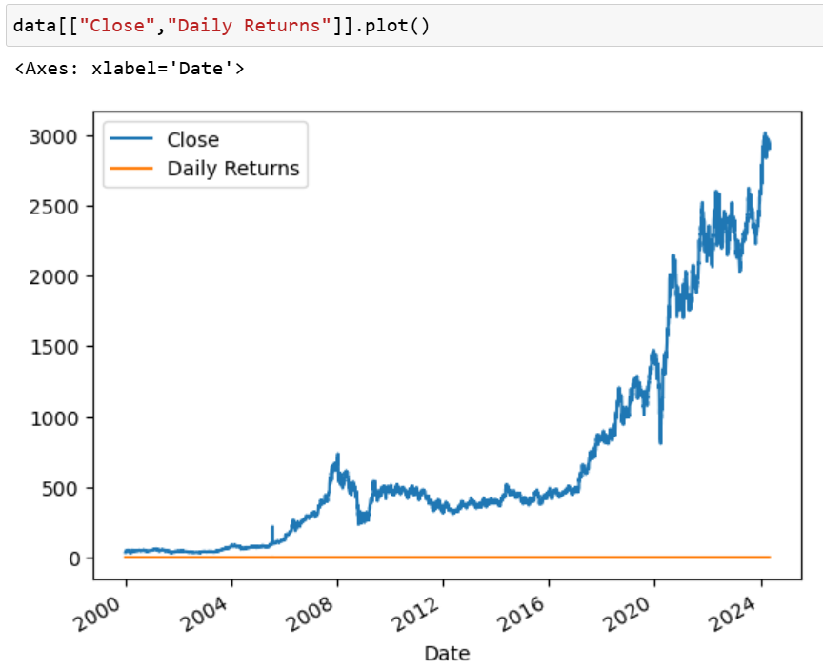
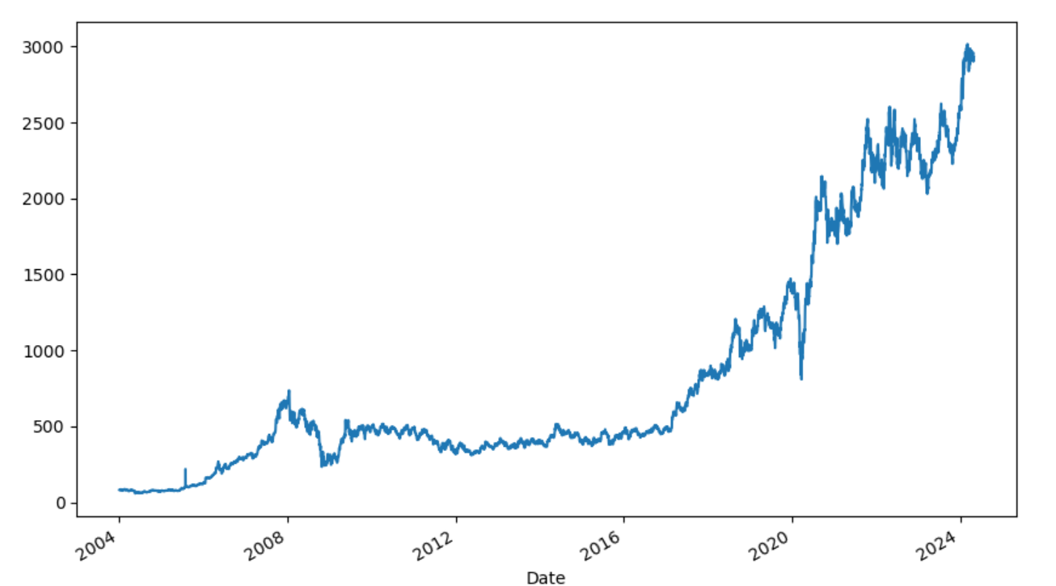

Slide 11
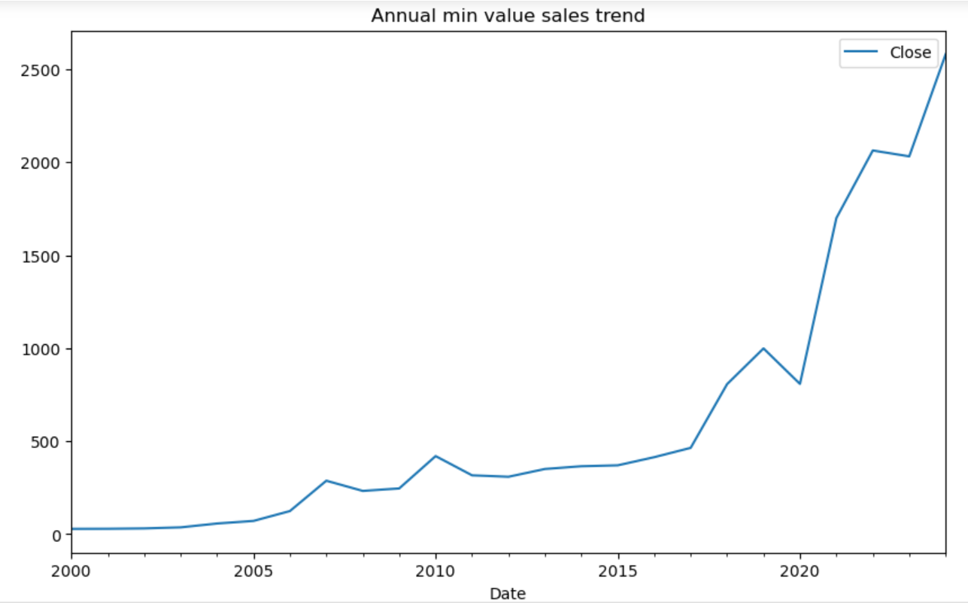
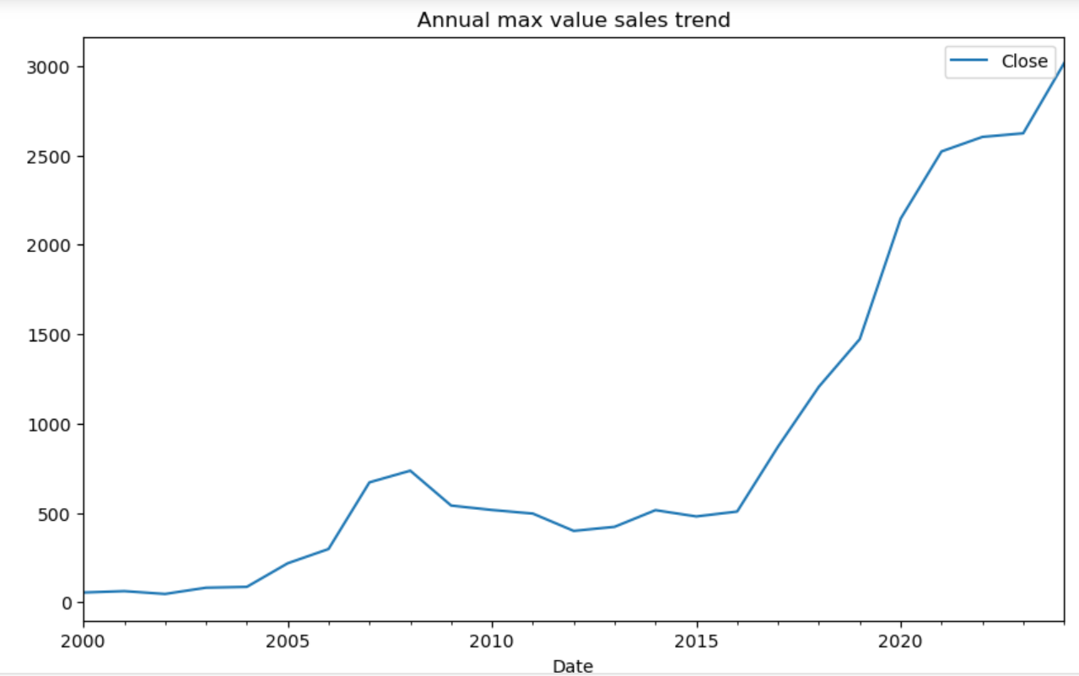

Slide 12
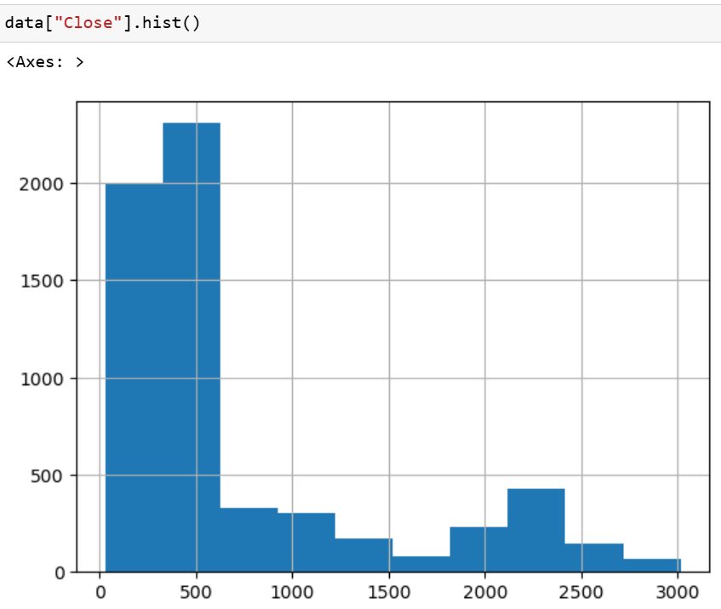
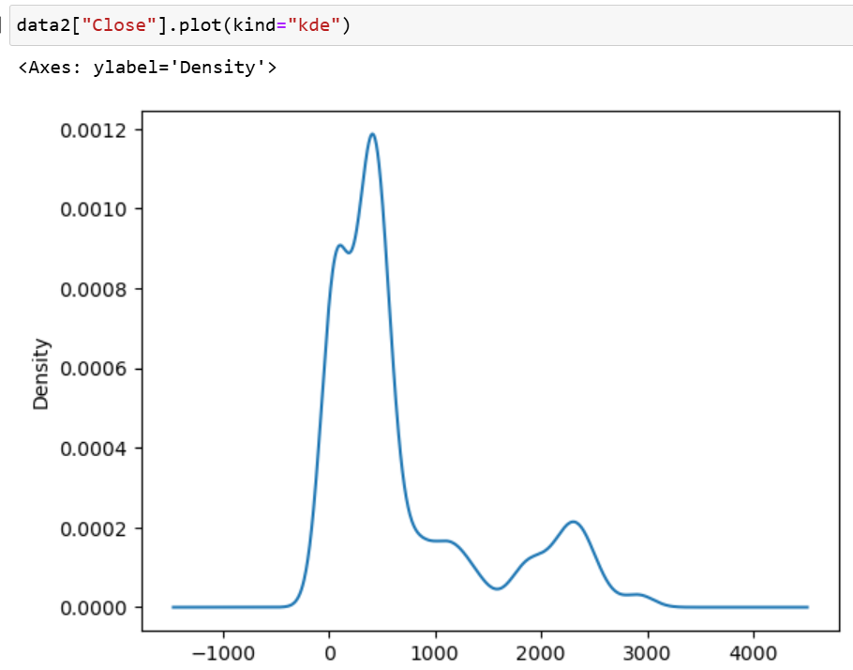

Slide 13
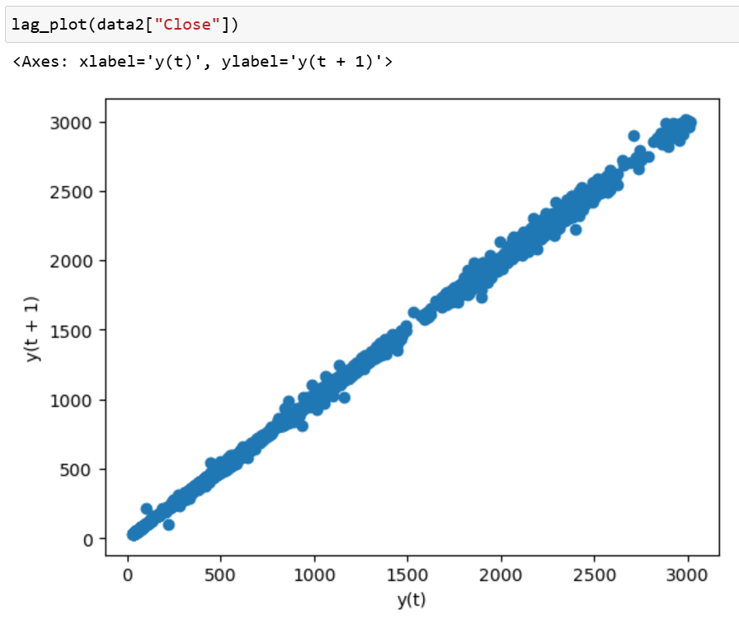
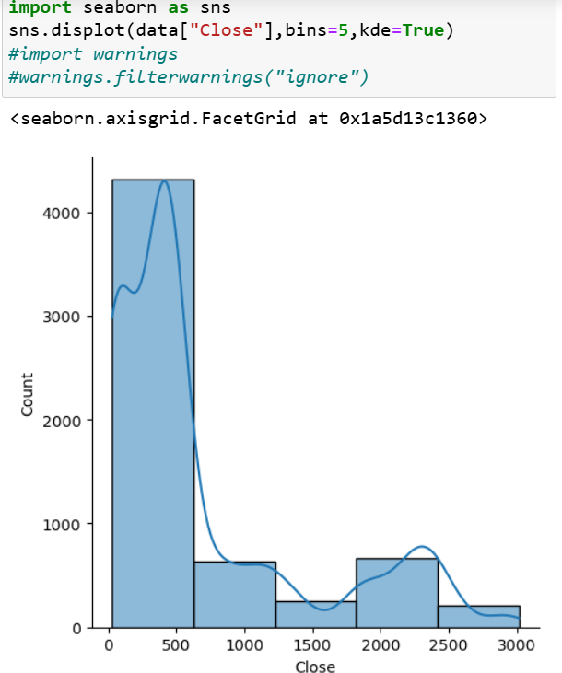

Slide 14
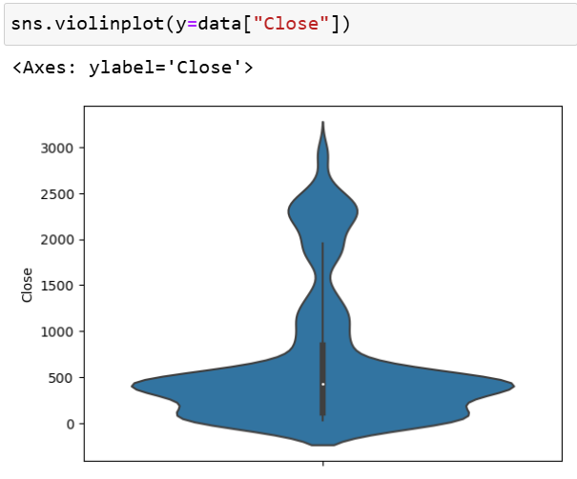
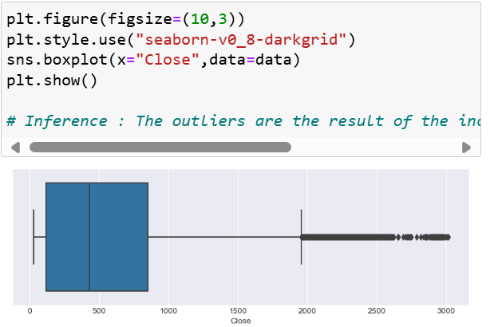

Slide 15
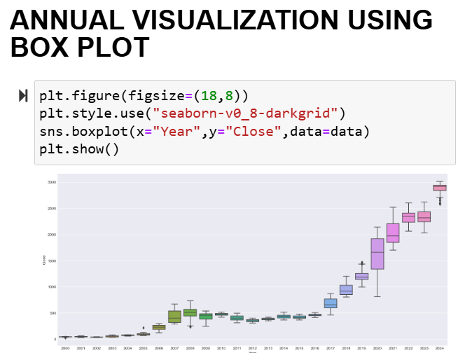
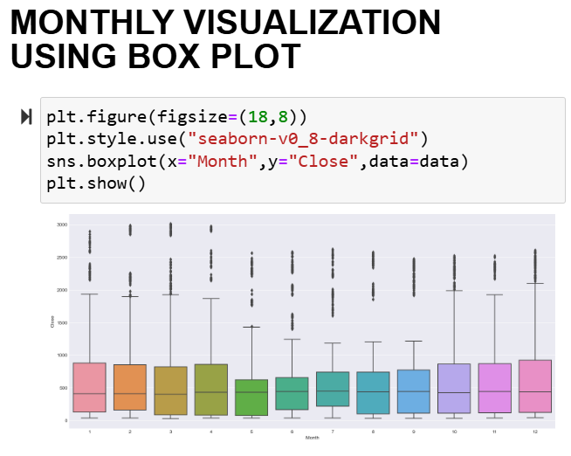

Slide 16
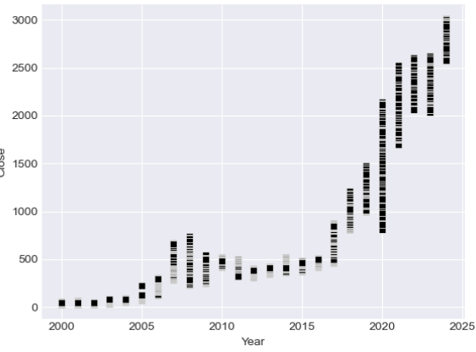
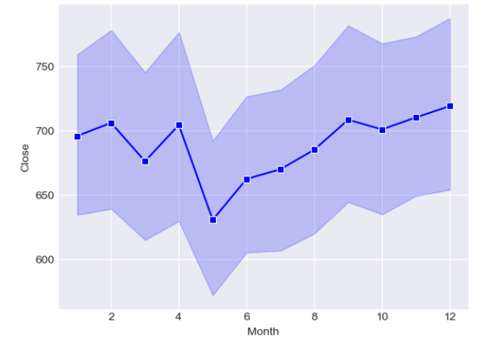
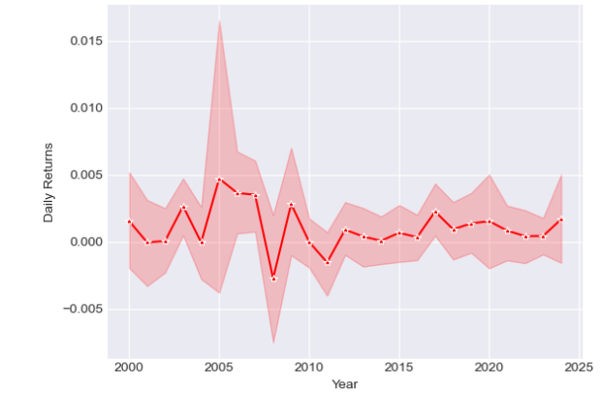
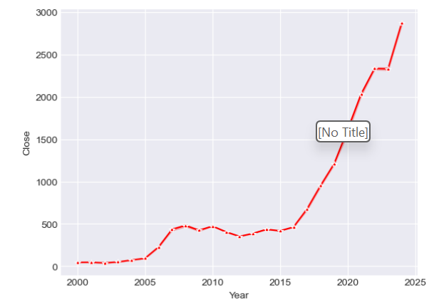

Slide 17
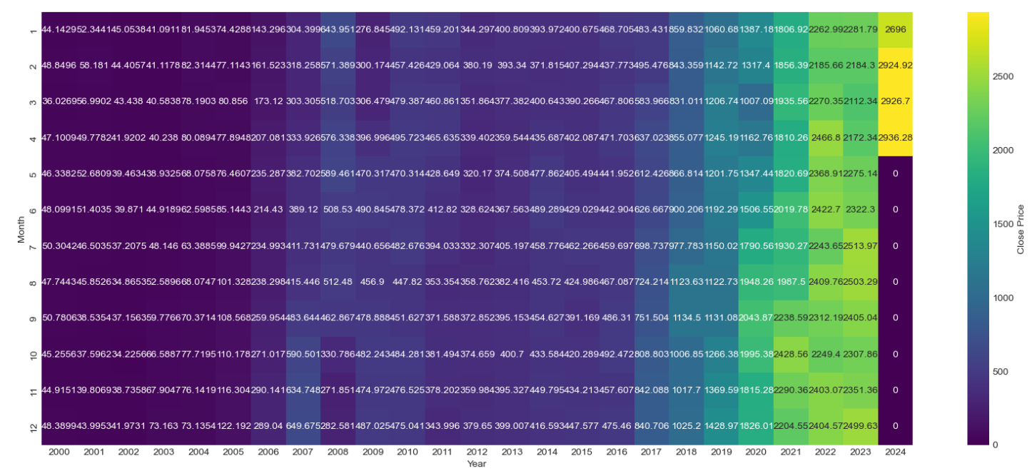
Heat Map: month and year

Slide 18
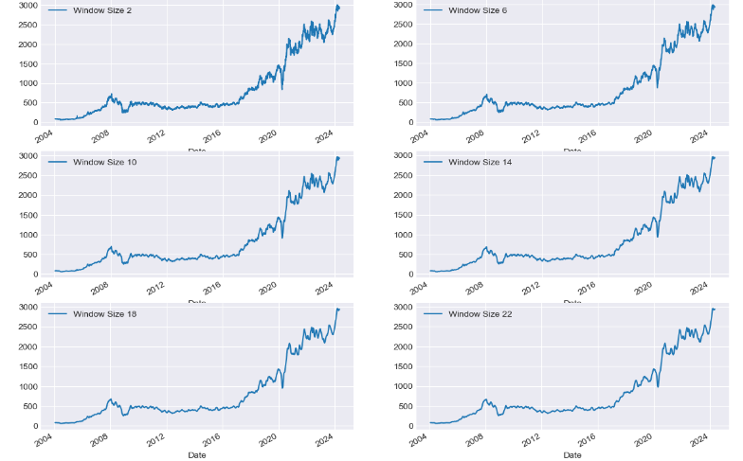
PLOTTING MOVING AVERAGES WITH DIFFERENT WINDOW SIZES

Slide 19
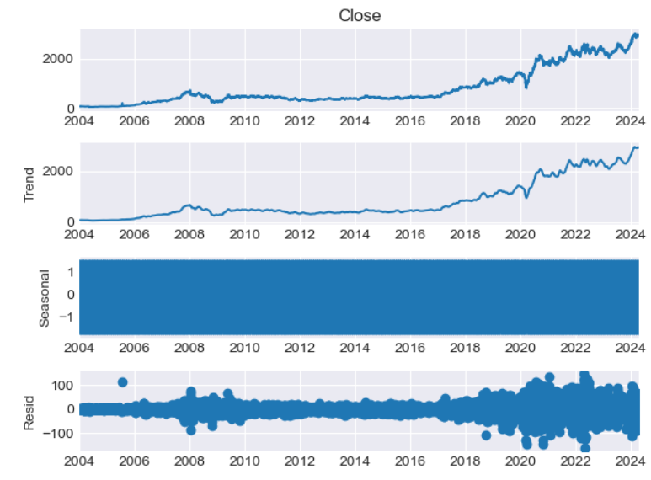
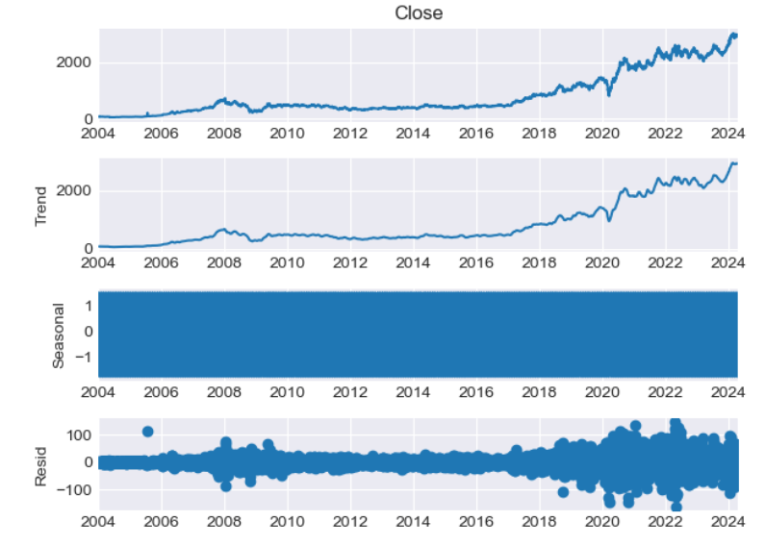
In our data we can observe that there is upward trend and no seasonality . THE DATA IS NOT CONSTANT , IT CONTAINS SOME VARIANCE , NOW LET US PLOT ACF AND PACF :
ACF : PROVIDES THE Q VALUE
PACF : PROVIDES THE P VALUE : FOR THE LAGS TO BE CONSIDERED.
IT GIVES THE CORRELATION WRT TO THE LAGS OVER THE PERIOD OF TIME , HIGHER THE LAGS LOWER THE CORRELATION .
ACF CONSIDERS THE DIRECT AND INDIRECT RELATIONSHIP PACF ELIMINATES THE INDIRECT RELATION PROVIDING AN EXPONENTIAL INCREASING CORRELATION.

Slide 20
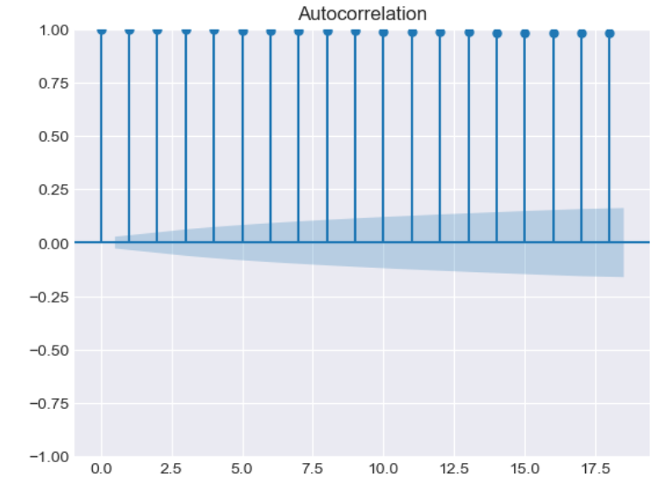
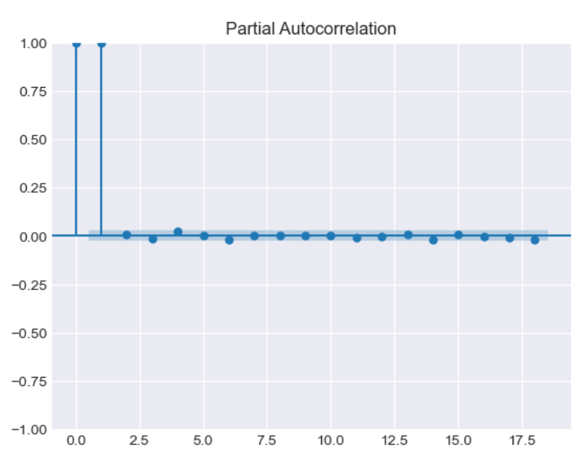

Slide 21
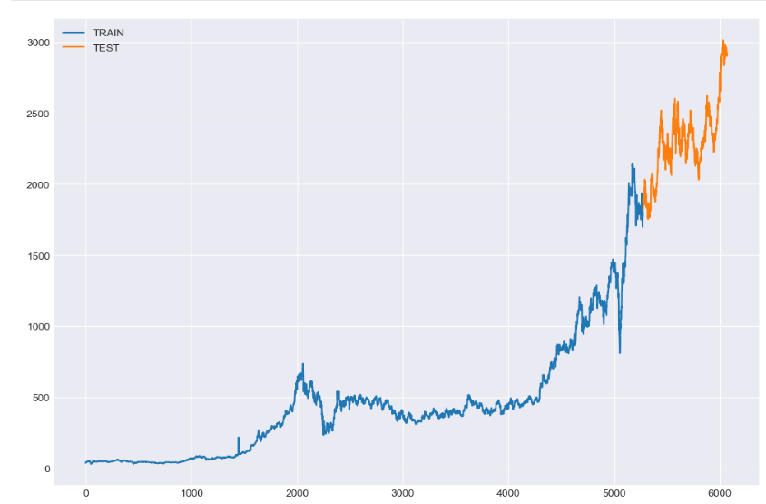
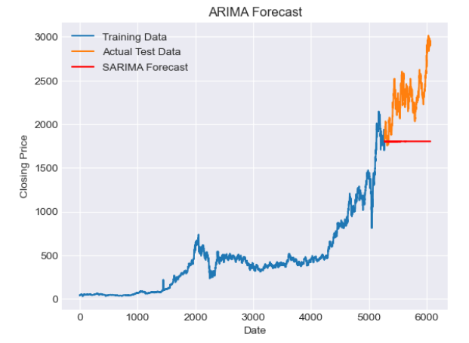

Slide 22
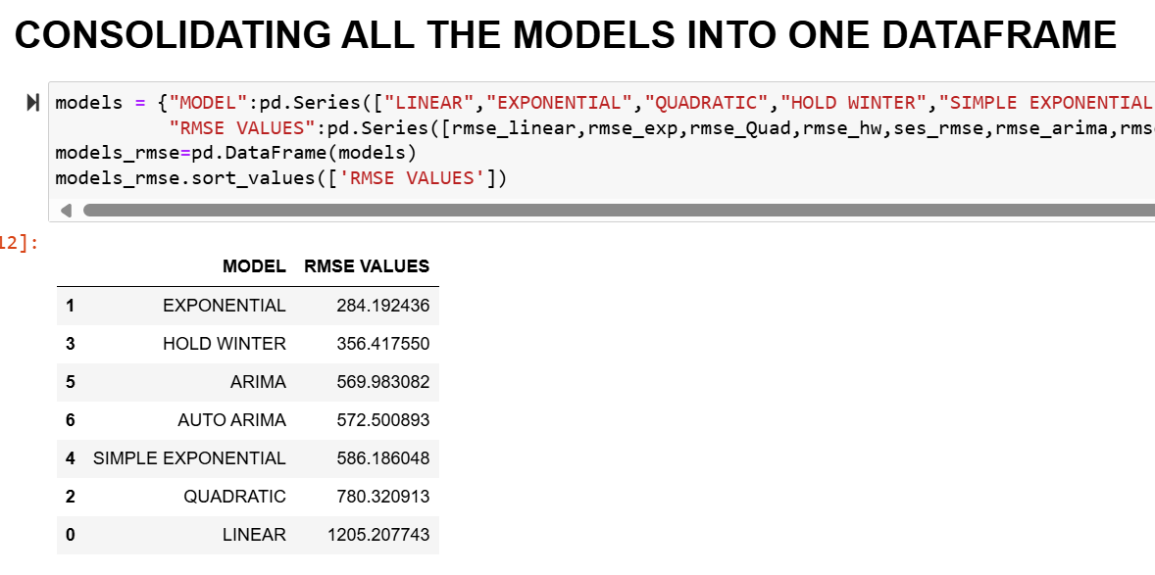

Slide 23
MACHINE LEARNING MODELS

Slide 24
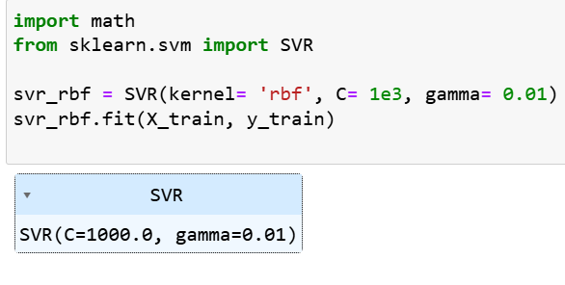
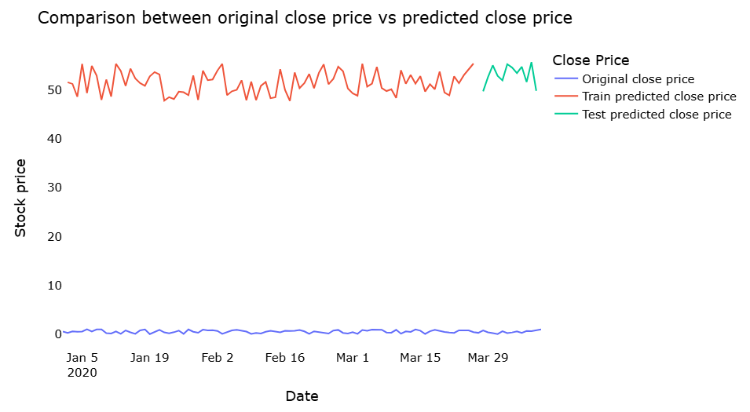
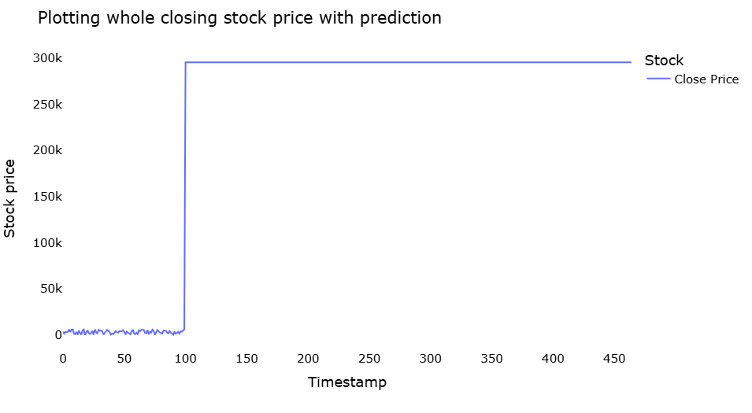
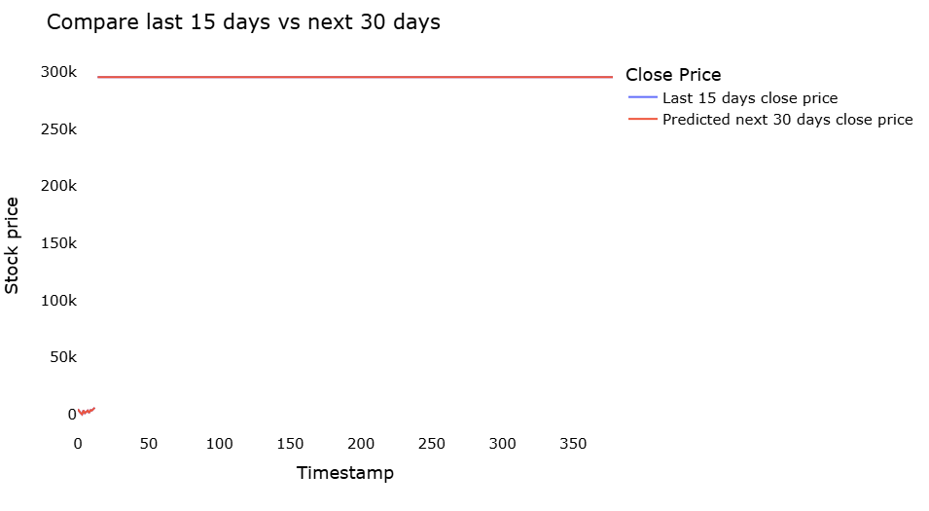

Slide 25
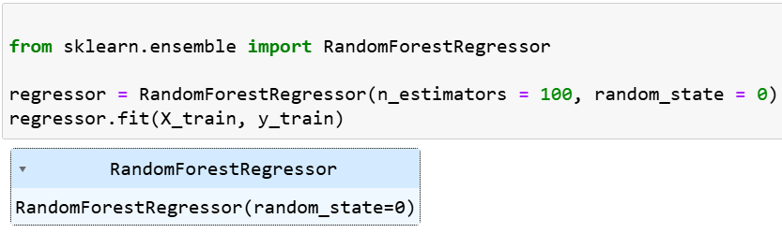
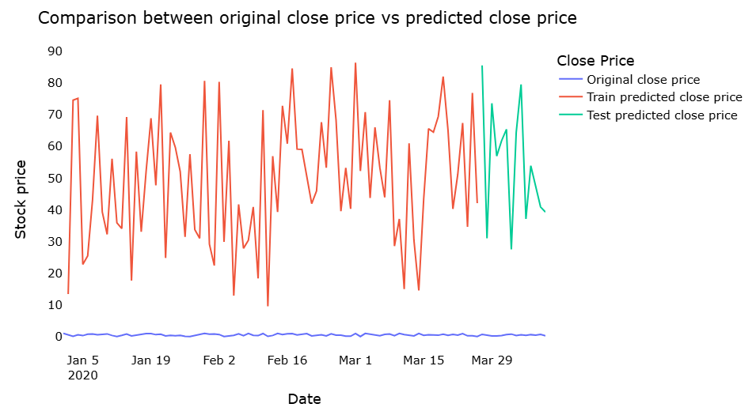
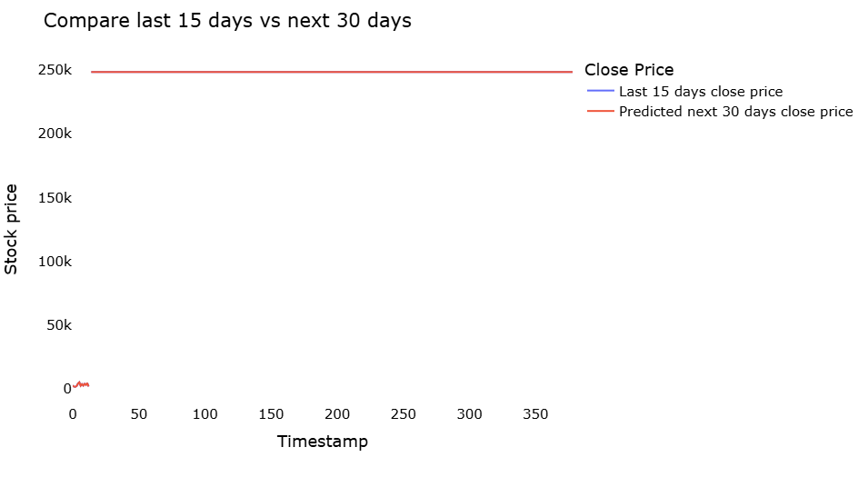
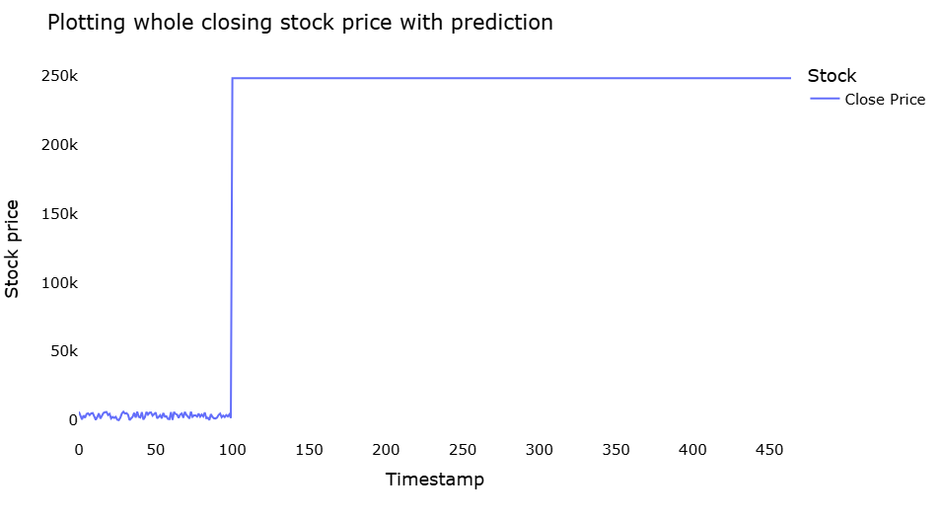

Slide 26
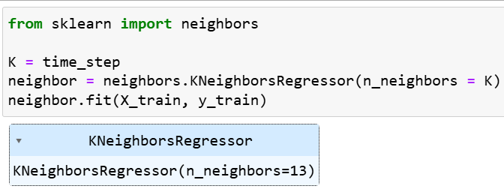
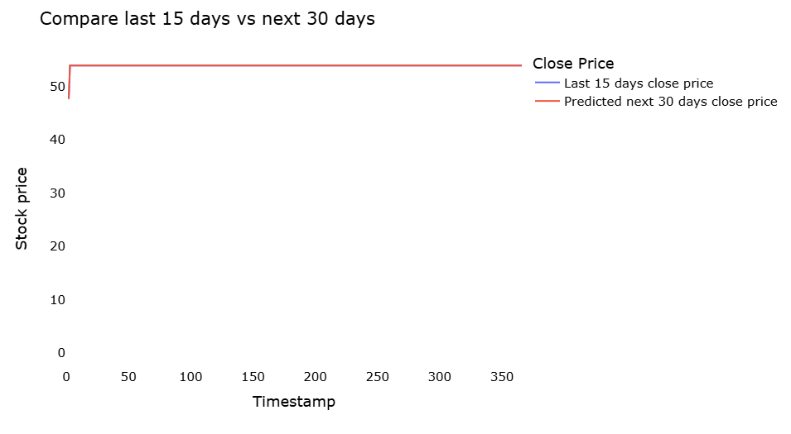
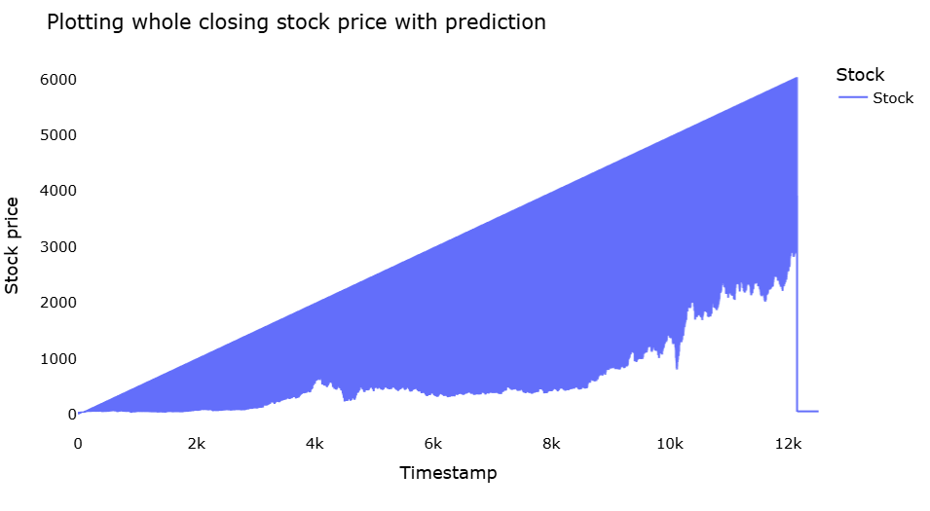

Slide 27
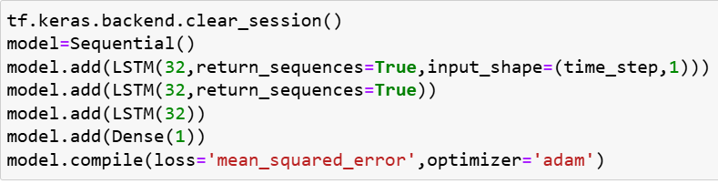

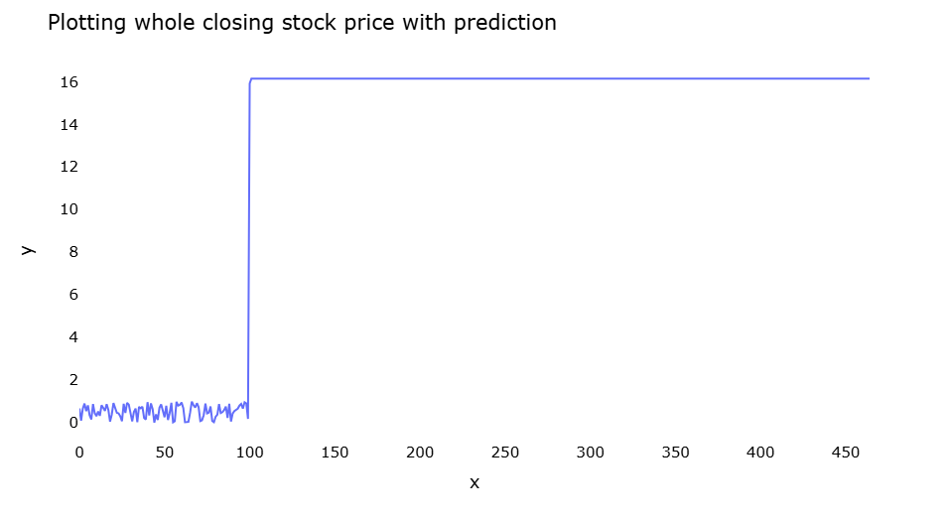

Slide 28
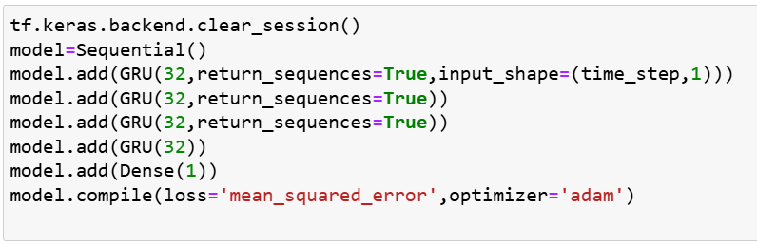
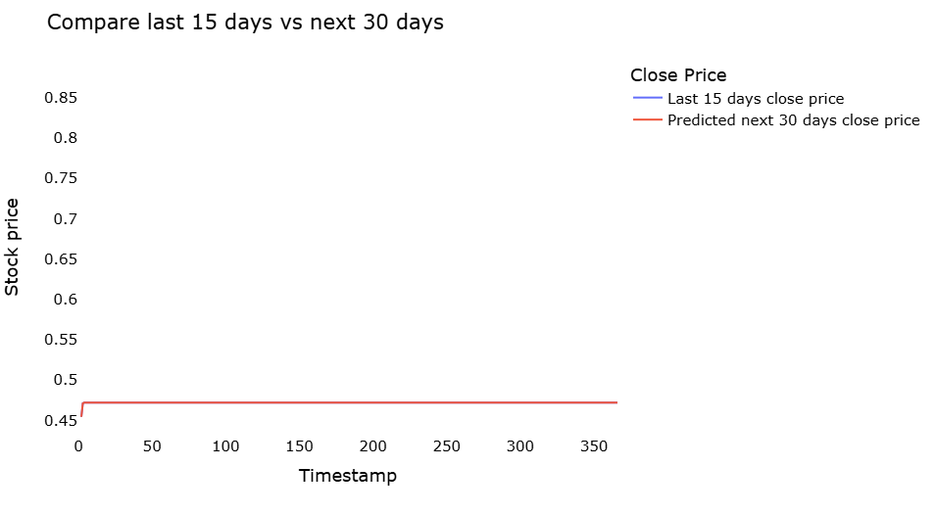
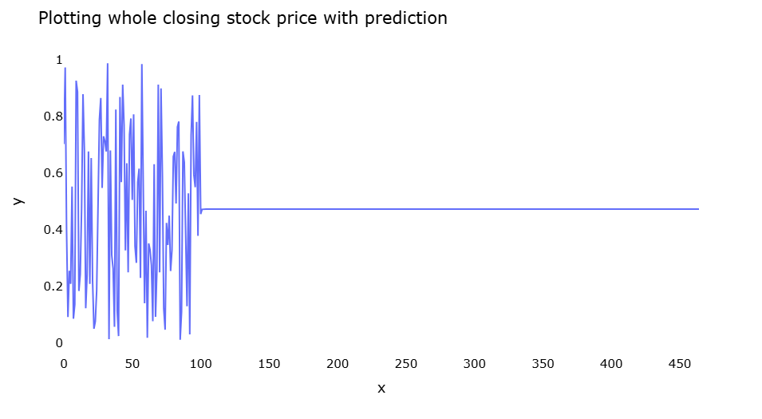

Slide 29
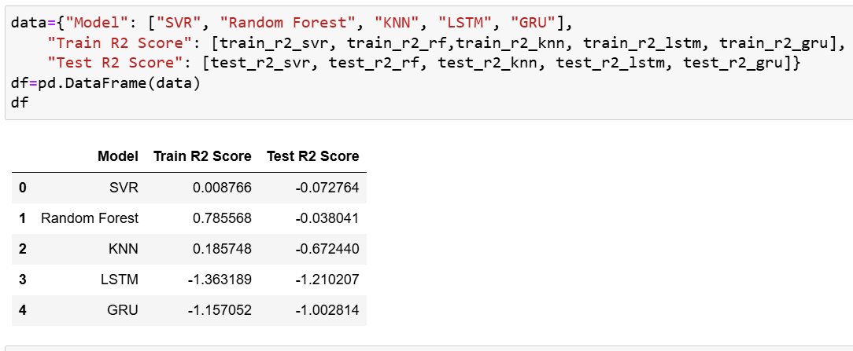

Slide 30
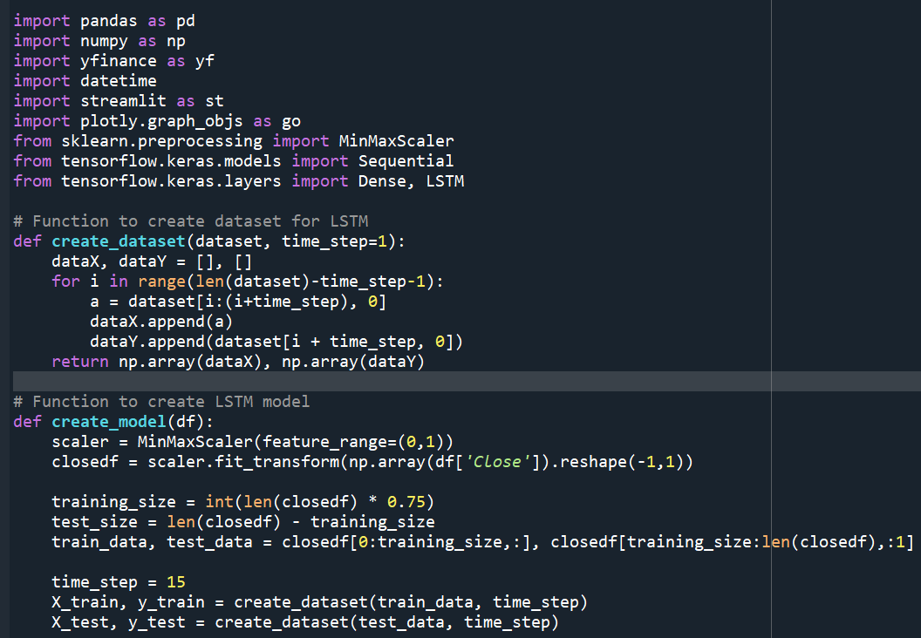
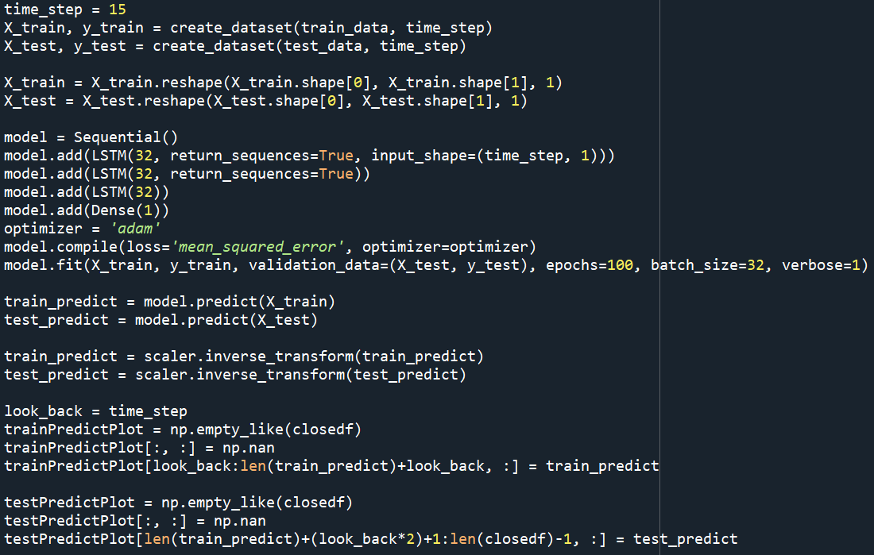
MODEL DEPLOYEMENT:

Slide 31
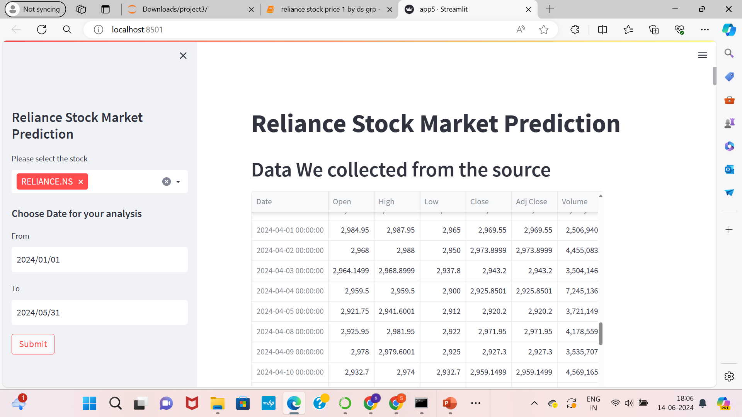

Slide 32
THANK YOU

